Slide 1
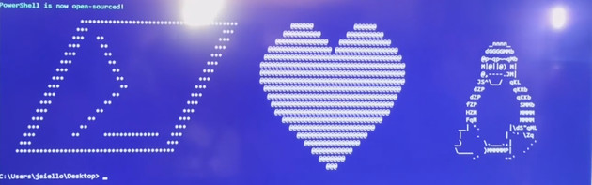
Start-NewEra.ps1 –Repo PowerShell
Ben Gelens, MVP, @bgelens, bgelens.nl, DevOps & Cloud Consultant @ InSpark

Slide 2
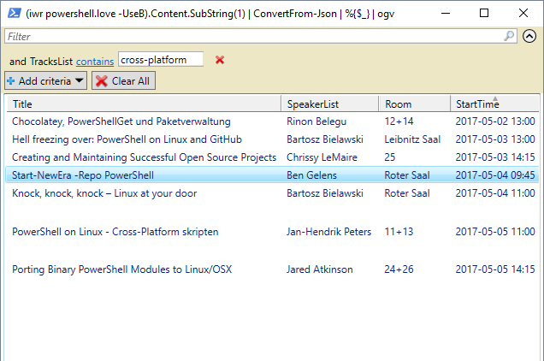
Notes:
PowerShell 6 is hot and happening. Just look at the amount of sessions I identified in the agenda. A strong presence at PSConfEU!
This session and Barteks session have some overlap. Because Bartek’s session already happened, I’m handling some basics really quickly and then I’ll dive right into demo’s hopefully not seen in Bartek s session
I am not a hardcore Linux guy. I can find my way but not core skill. PowerShell helps me! I will show you how it can help you too ☺
Besides Linux discovery through PS, I’m handling some DSC and Remoting.

Slide 3
Agenda
Announcement
Important GitHub Repositories
Demos!
Summary
Questions

Slide 4



Announcement:
On August 18th2016 @ 11:14EST, PowerShell was made available on *NIX, OSX and Windows.
Current version: 6.0.0-alpha.18
Also, PowerShell now is OSS using MIT license!
PSRP over SSH!
Notes:
11:14 (14 November 2006) = Public Release PS1

Slide 5
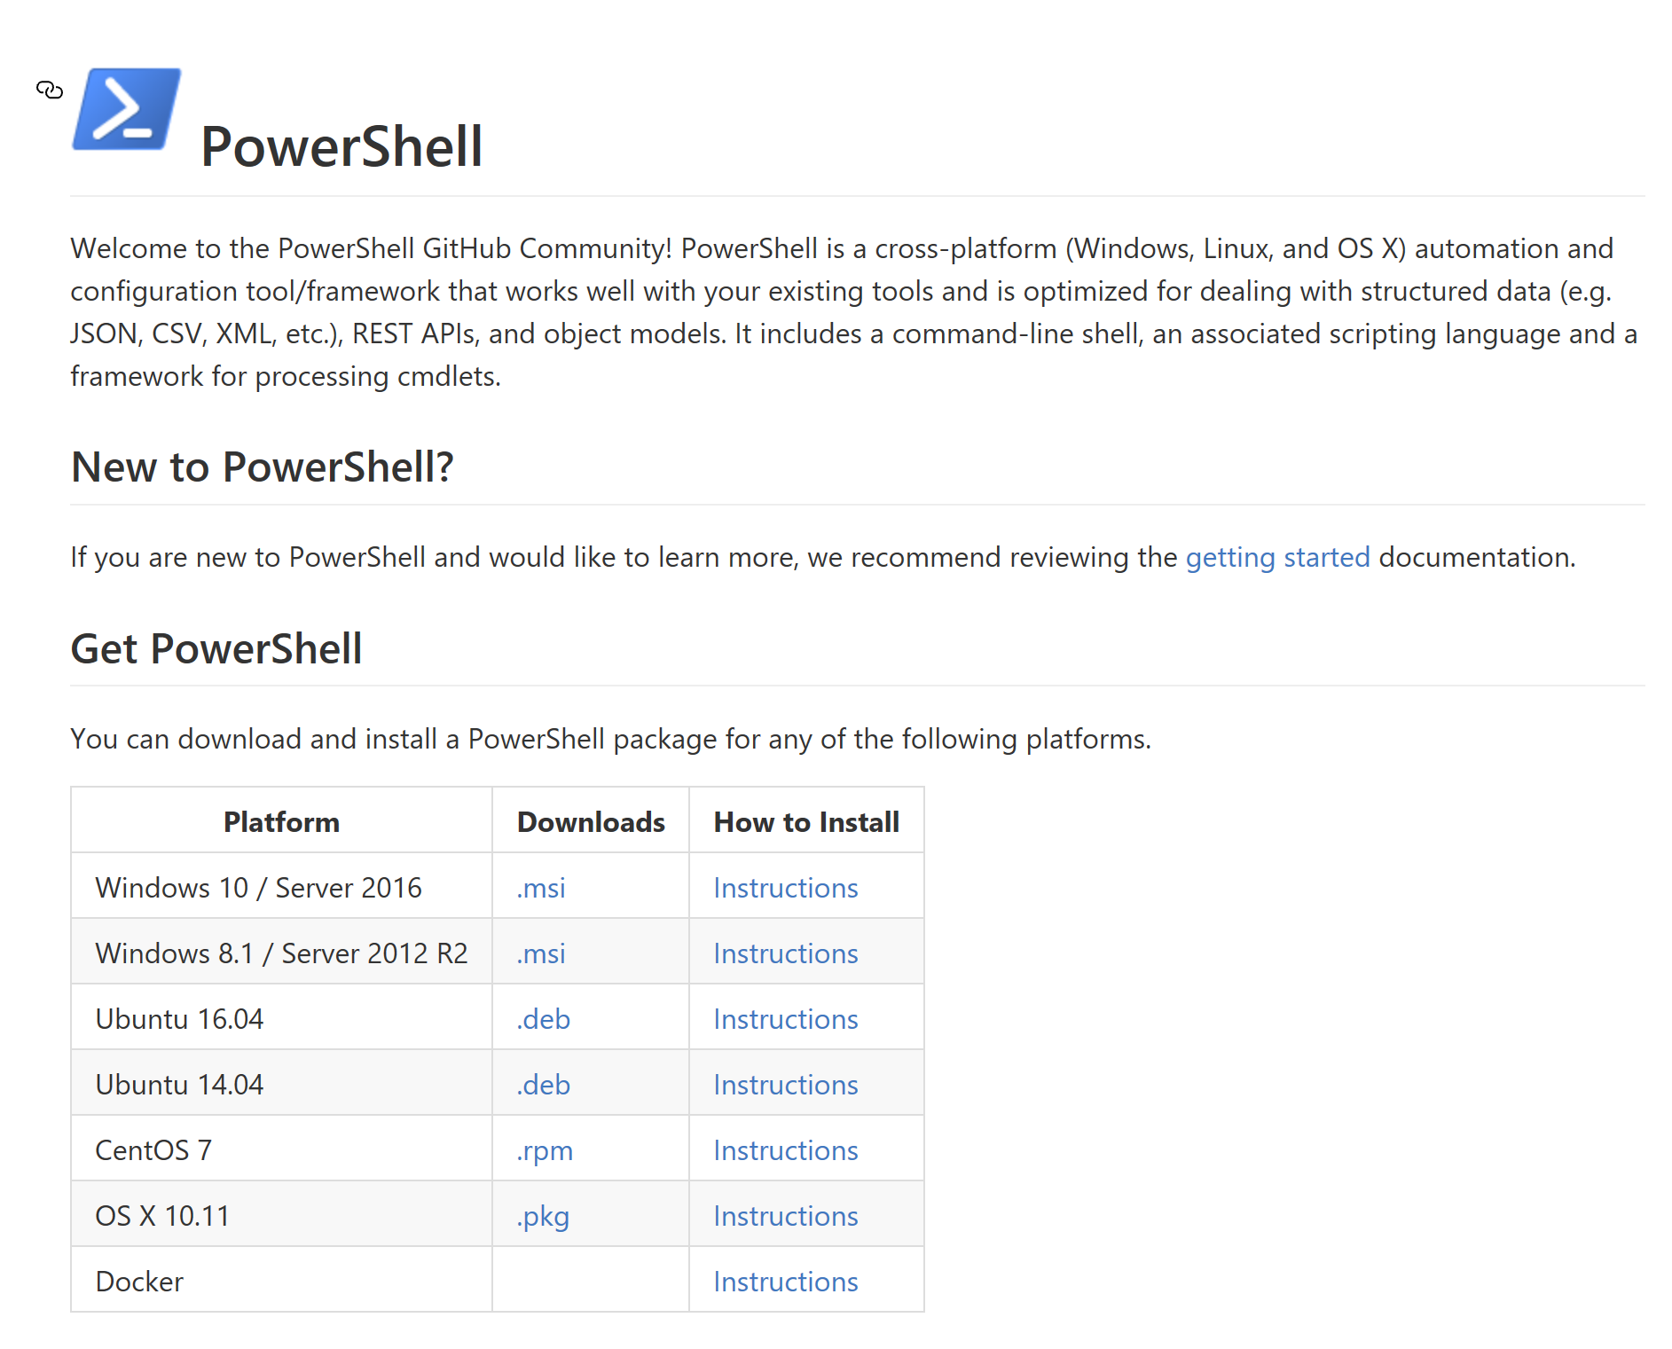

Important GitHub Repositories
https://github.com/..
* PowerShell/PowerShell
* Microsoft/omi
* PowerShell/psl-omi-provider
* Microsoft/PowerShell-DSC-for-Linux
* PowerShell/Win32-OpenSSH
* PowerShell/PowerShell-RFC

Slide 6





Slide 7


Summary
Notes:
PowerShell 6 goes xPlat which enables Microsofties to better explore / embrace the *Nix OS.
Another shell / tool for *Nix people which is optimized for dealing with structured data (like JSON, CSV, XML, etc), REST APIs, and object models.
Enables cloud management xPlat
Add / fix your own ideas!
PSRP over SSH will crush the firewall debate.. 22 is open everywhere ☺
Still Alpha but going strong.
VS Code xPlat ISE replacement

Slide 8
Next Steps...
Now: 15 min break
Grab a coffee
Stay here to enjoy next presentation
Change track and switch to another room
Ask me questions or meet me in a breakout session room afterwards

Slide 9
Questions?

Slide 10
Get-MyInfo
Name : Ben Gelens
Job : Consultant
MVP : CDM (PowerShell)
Company : InSpark
Email : ben@bgelens.nl
Twitter : @bgelens
GitHub : bgelens
Community : {Hyper-V.nu, azurestack.blog, DuPSUG}
Blogging : {bgelens.nl, Hyper-V.nu, PowerShellMagazine.com, azurestack.blog}

